Slide 1


CHEQUE SCANNER

Slide 2
Team Details
College Name : Indus University Ahmedabad
Mentor : Sejal Thakkar
By Yashas Majmudar
Saumya Ramolia
Ritika Dhall
Khushi Manek
Frenil Patel
Team Leader Email: yashashm@gmail.com

Slide 3
PROBLEM STATEMENT & ITS OBJECTIVE
Enhance user usability by focusing on:
high-quality cheque scanners can yield high ROIs
By saving huge amount of Time, Money and Resources.
Easy Banking Experience.(Remote Deposit Capture)

Slide 4
INTRODUCTION ON PROBLEM STATEMENT
Every Bank has the same old system of depositing a cheque by going there personally. We need to fill in all the details while standing in a long queue. That is why in this modern techno world we need an application where we can deposit cheque sitting at home/office. This will save our lot of time and energy.
Addition to this, during this time of pandemic, creating an autonomous system for cheque collection and submission remotely is safer and easier.

Slide 5
CHEQUE SCANNER FLOW CHART
Scan from camera or gallery
Image sent to google text recognition API
Image processed with dataset and models
Returns Text Blocks
Render procured data
Save to Database

Slide 6
FEATURES OF CHEQUE SCANNER
Autonomous Text detection
High Confidence

Slide 7

RESULT
The software gives accurate/precise textrecognition data. The data can be saved and shared easily readable format.

Slide 8
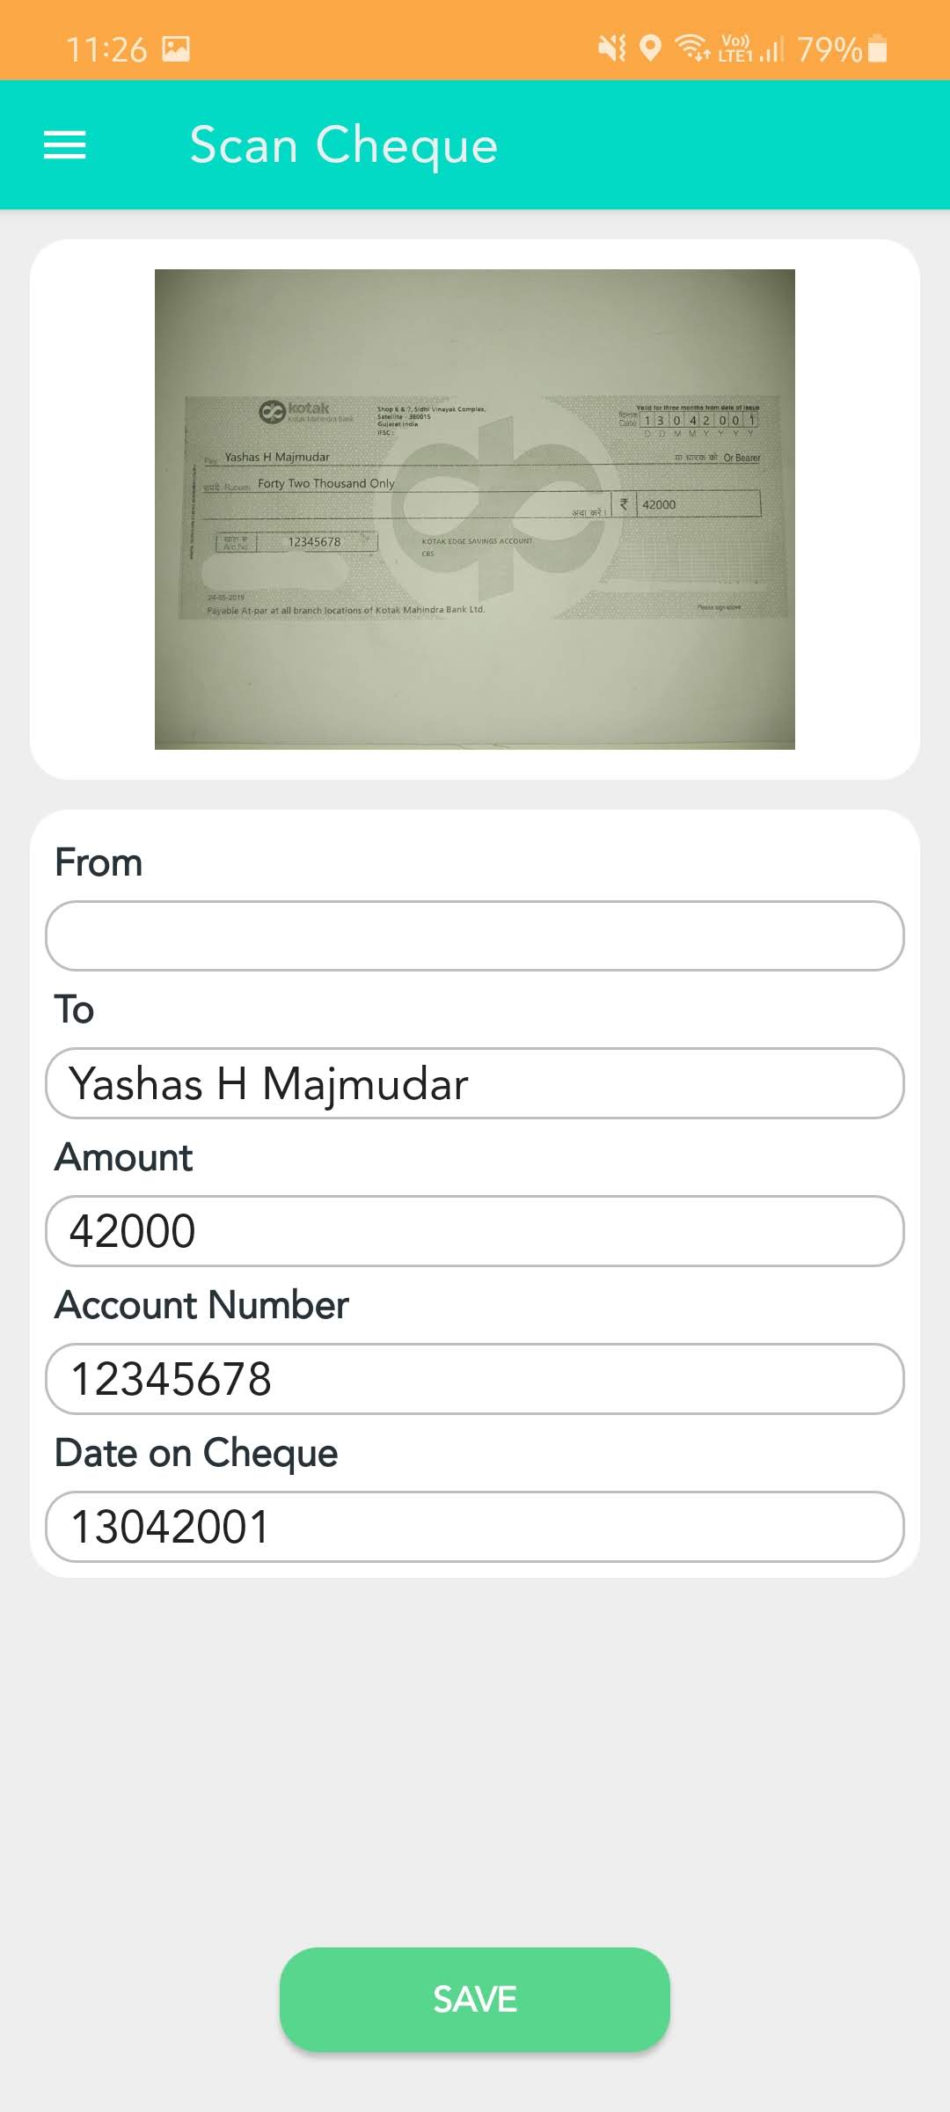
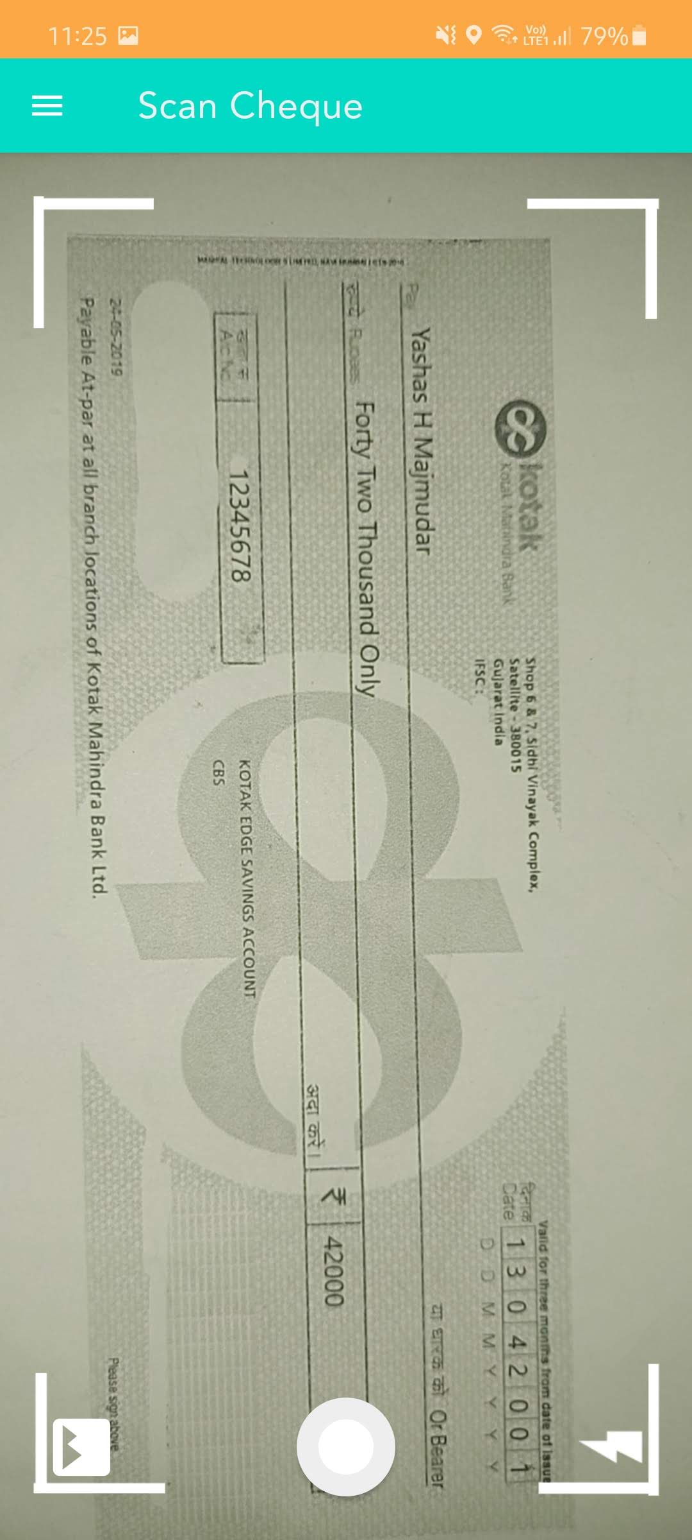
Demo Images

Slide 9
CONCULSION
Simple and easy to use app on android device.
Saves time, Money and Resources
Improves Data Efficiency

Slide 10
Future Advances
The text recogizer can be configured more strongly to give more accurate text recognition.
Can be integrated within bank apps to directly process cheque data.

Slide 11
References
Android Firebase
ML Kit Google
SDP Library

Slide 12

THANK YOU

